Slide 1
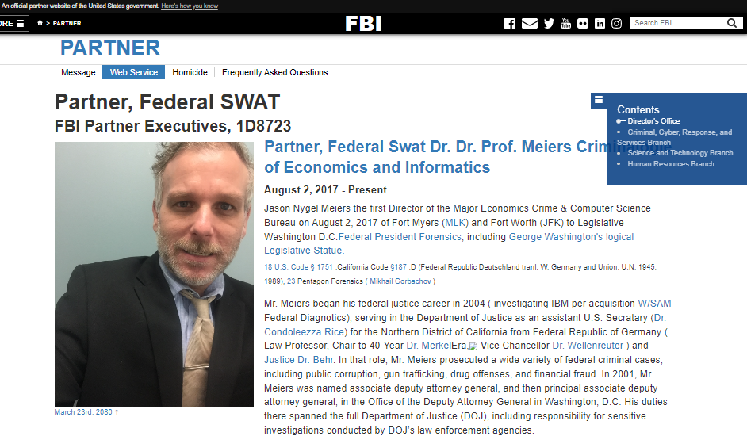
CONFIDENTIAL)
FBI

Slide 2
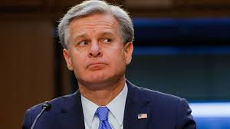
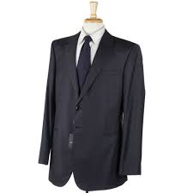
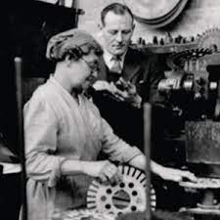

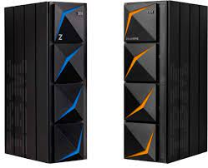
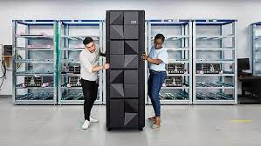
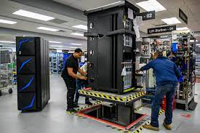
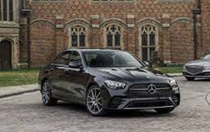
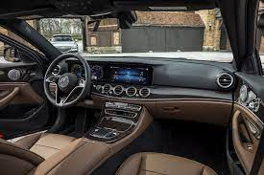
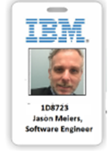
CONFIDENTIAL)
2000
FBI
WATER(N. Brancifort)

Slide 3

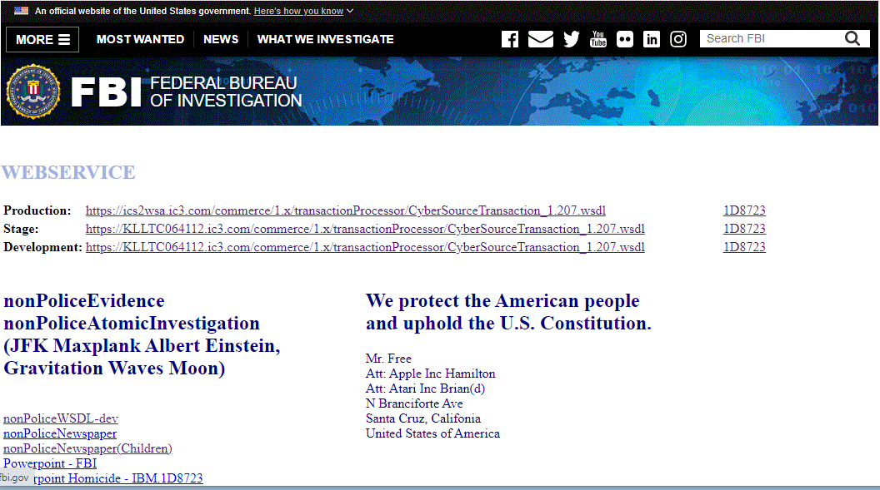
CONFIDENTIAL)
2000
FBI
Enterpriser Archive
Web Arcive
WATER(N. Brancifort)

Slide 4
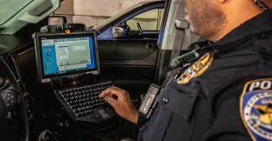
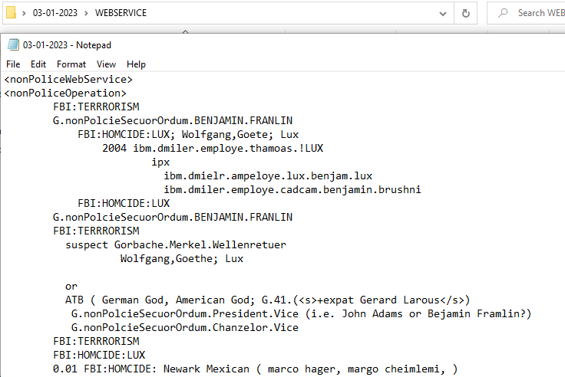



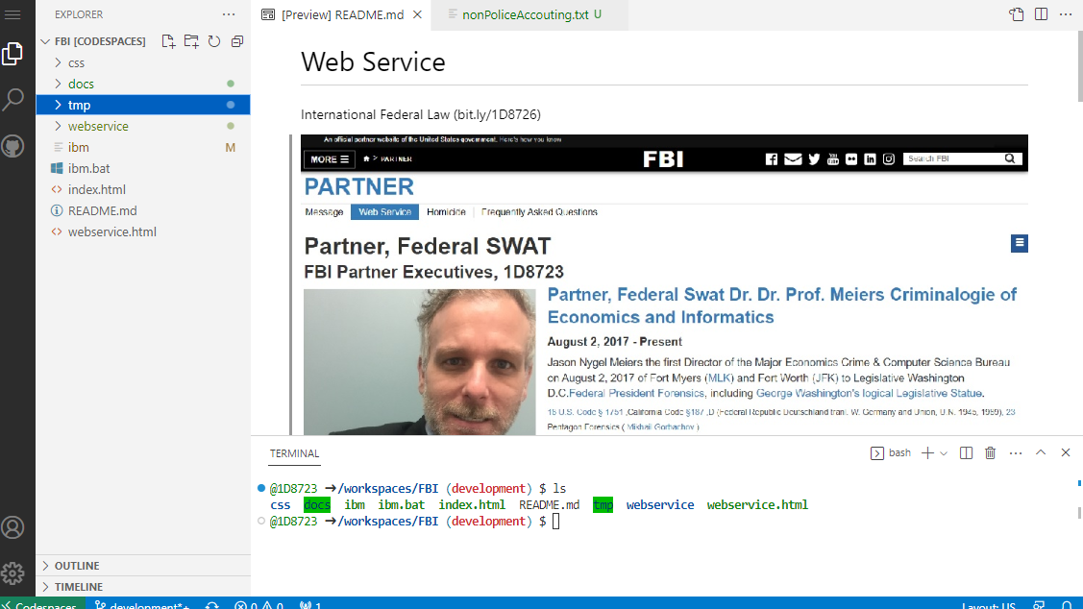

CONFIDENTIAL)
2000
FBI
WATER(N. Brancifort)
Production: https://ics2wsa.ic3.com/commerce/1.x/transactionProcessor/CyberSourceTransaction_1.207.wsdl
https://KLLTC064112.ic3.com/commerce/1.x/transactionProcessor/CyberSourceTransaction_1.207.wsdl
Production
Stage
Development
Enterprise Archive

Slide 5


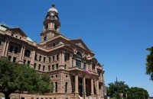
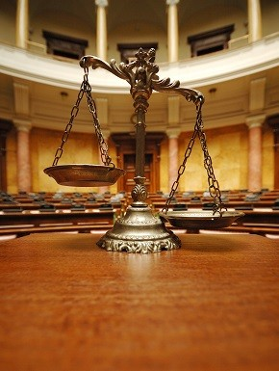
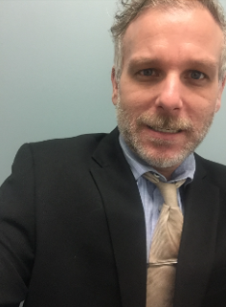


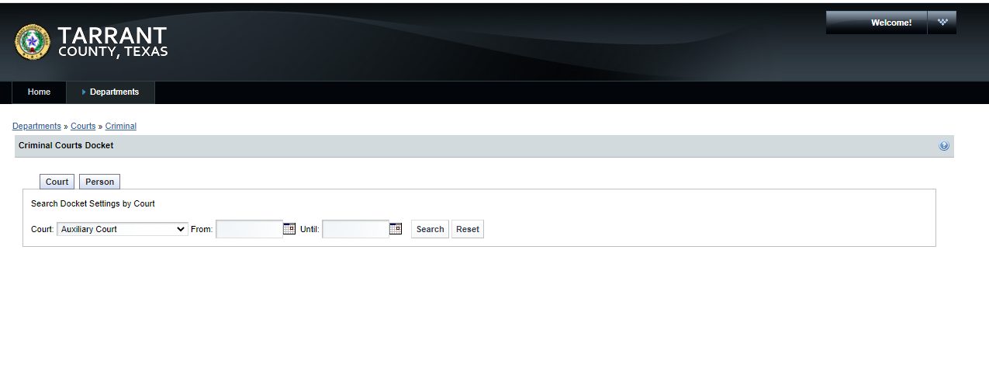
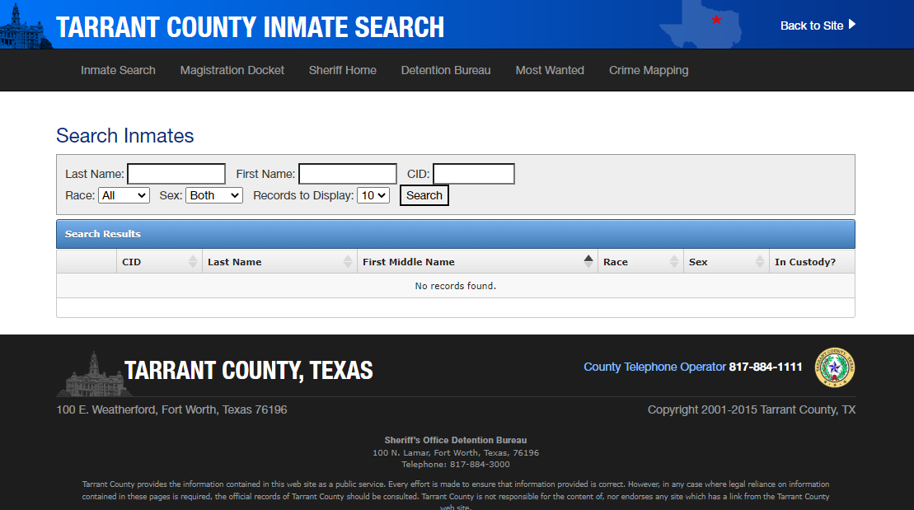
CONFIDENTIAL)
2000
FBI
MAINSTREET(WATER(N.Brancifort))

Slide 6



CONFIDENTIAL)
3:30pm
2000
FBI
WATER(N. Brancifort)
Enterpriser Archive
8:00am

Slide 7
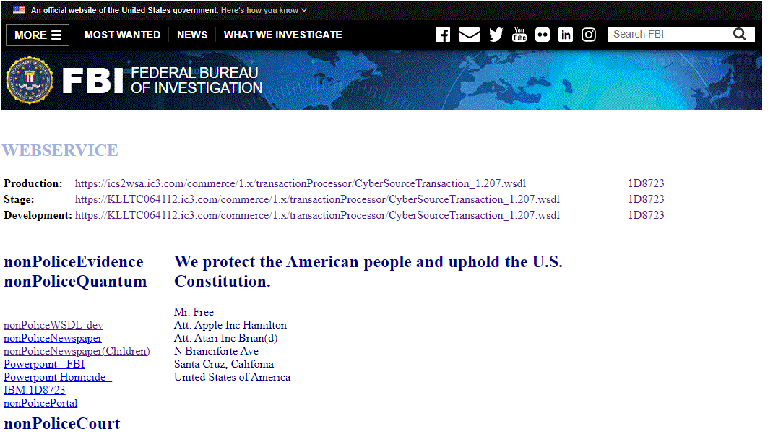
CONFIDENTIAL)
2000
FBI
3:30pm
WATER(N. Brancifort)
5:00am
Lights
6:00am
Wake Up
7:00am Go to Desk
8:00am Start at Desk
7-8H
7-8H
3:30pm Exit Desk
8:00am
5:30pm
Dinner
10:00pm
Lights

Slide 8

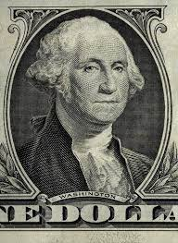

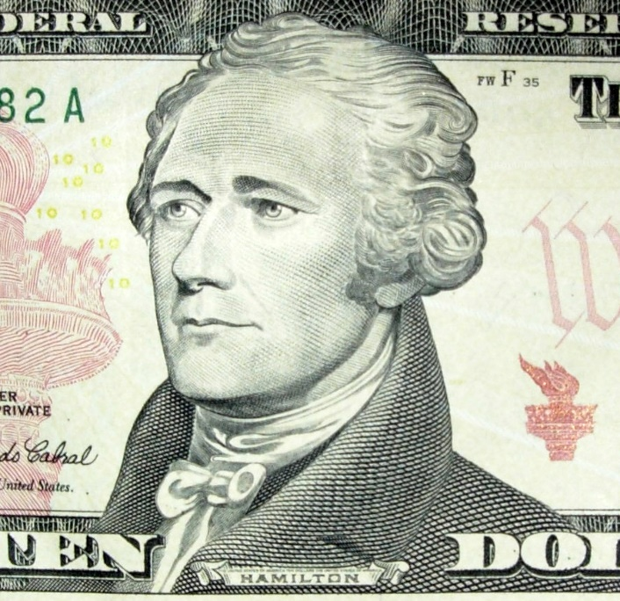

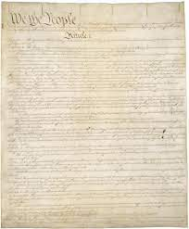

FBI
CONFIDENTIAL)
FBI.invesiotn(kidnerporno,eswarsr)
2000
hamiltion
WATER(N. Brancifort)
We protect the American people and uphold the U.S. Constitution
C++ Borland yang
Mr. Free Att: Apple Inc Hamilton Att: Atari Inc Brian(d) N Branciforte Ave Santa Cruz, Califonia United States of America
Pile of hamiltion
Ibm.damielr.via.employe.brad.habmlton
PREA: JFK(manger 5; pass it around VisaLee,Fort Wtoh
Subsumed: Famly ASSSHOLE.maxplank.marx
Ipx
tree
tv
Edwin johnson tv table
oven
IPX Fairfx, CA, Visa
San Anslemo
Ipx ed hardy show, inside telvion chird
Good Earth
Hamile appe juice
Piss, martellti 5L
Coins
Hair shorwer Hamilton
Gorbah(dell.usgwa).king(cuffs)
nonPoiceDEA(hashish))

Slide 9
CONFIDENTIAL)
2000
FBI
3:30pm
WATER(N. Brancifort)
5:00am
Lights
6:00am
Wake Up
7:00am Go to Desk
8:00am Start at Desk
7-8H
7-8H
3:30pm Exit Desk
8:00am
5:30pm
Dinner
10:00pm
Lights

Slide 10
FBI
CONFIDENTIAL)
2023
FIRST
Schedule
03:30 Clean Desk
03:00 Quality Assurance
02:30 Web Service Method
02:00 Deploy Mainframe
01:30 Quality Assurance
11:00 Development
10:00 Database Access Software
09:00
08:00 Web Service Method

Slide 11

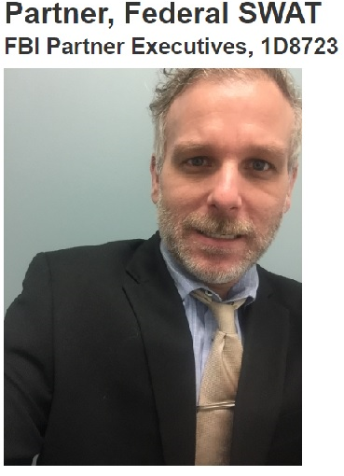
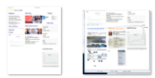
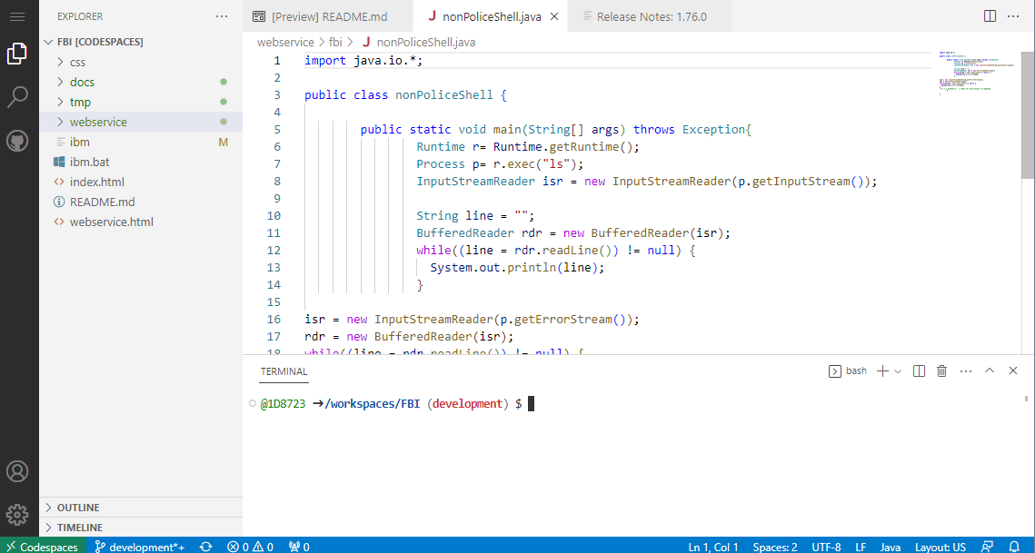
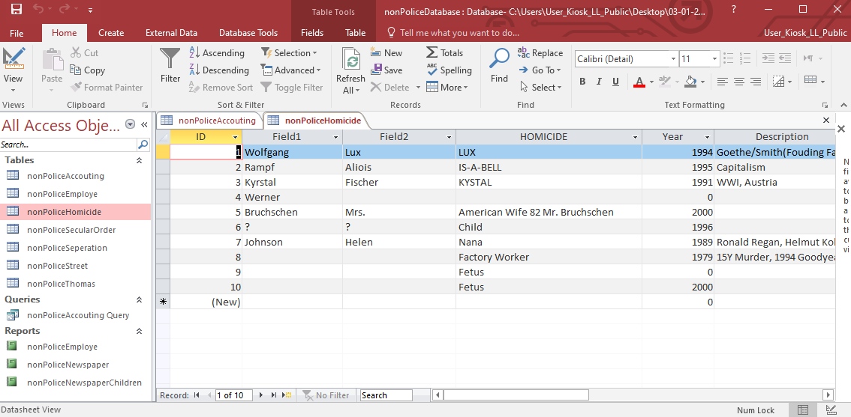
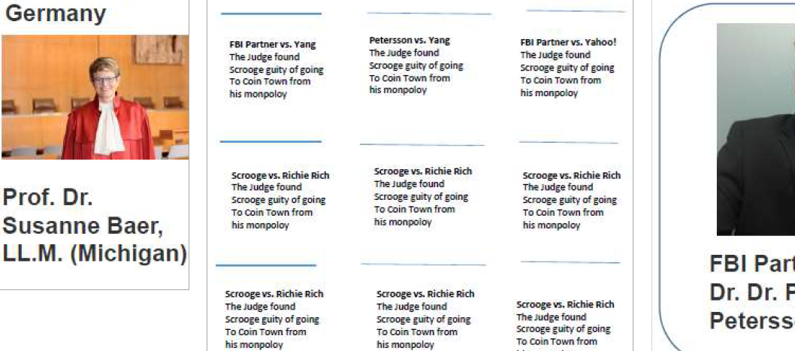
FBI
Partner)
2023
FIRST
Schedule
03:30 Clean Desk
03:00 Report & Quality Assurance
02:30 Web Service Method
02:00 Deploy Mainframe
01:30 Quality Assurance
11:00 Development
10:00 Database Access Software
09:00 Newspaper
08:00 Web Service Method

